Slide 1
City of Bandon
TRANSPORTATION SYSTEM PLAN
Project Advisory Committee Meeting #1
June 6, 2023 – 12:30 – 2:00 PM
Notes:
Dana

Slide 2
Meeting Guidelines
Please mute when not speaking
Let us know when you’d like to speak:
Send a note in chat
Use the “raise hand” feature
If we don’t get to your comment/question, email Dana after the meeting: dnichols@ci.bandon.or.us
Please promote respectful dialogue and comments
Notes:
Dana

Slide 3
Agenda
Welcome and Introductions
TSP Context
Overview of project
Key issues
Goals and Objectives
Next Steps
Notes:
Dana

Slide 4
Introductions
Name
Affiliation, interest
What do you love about Bandon?
Notes:
Dana

Slide 5
PAC Role
Participate in all five meetings
Help review goals, identify needs, select projects
Advise and provide feedback to the TSP team throughout the process
Notes:
Ryan

Slide 6
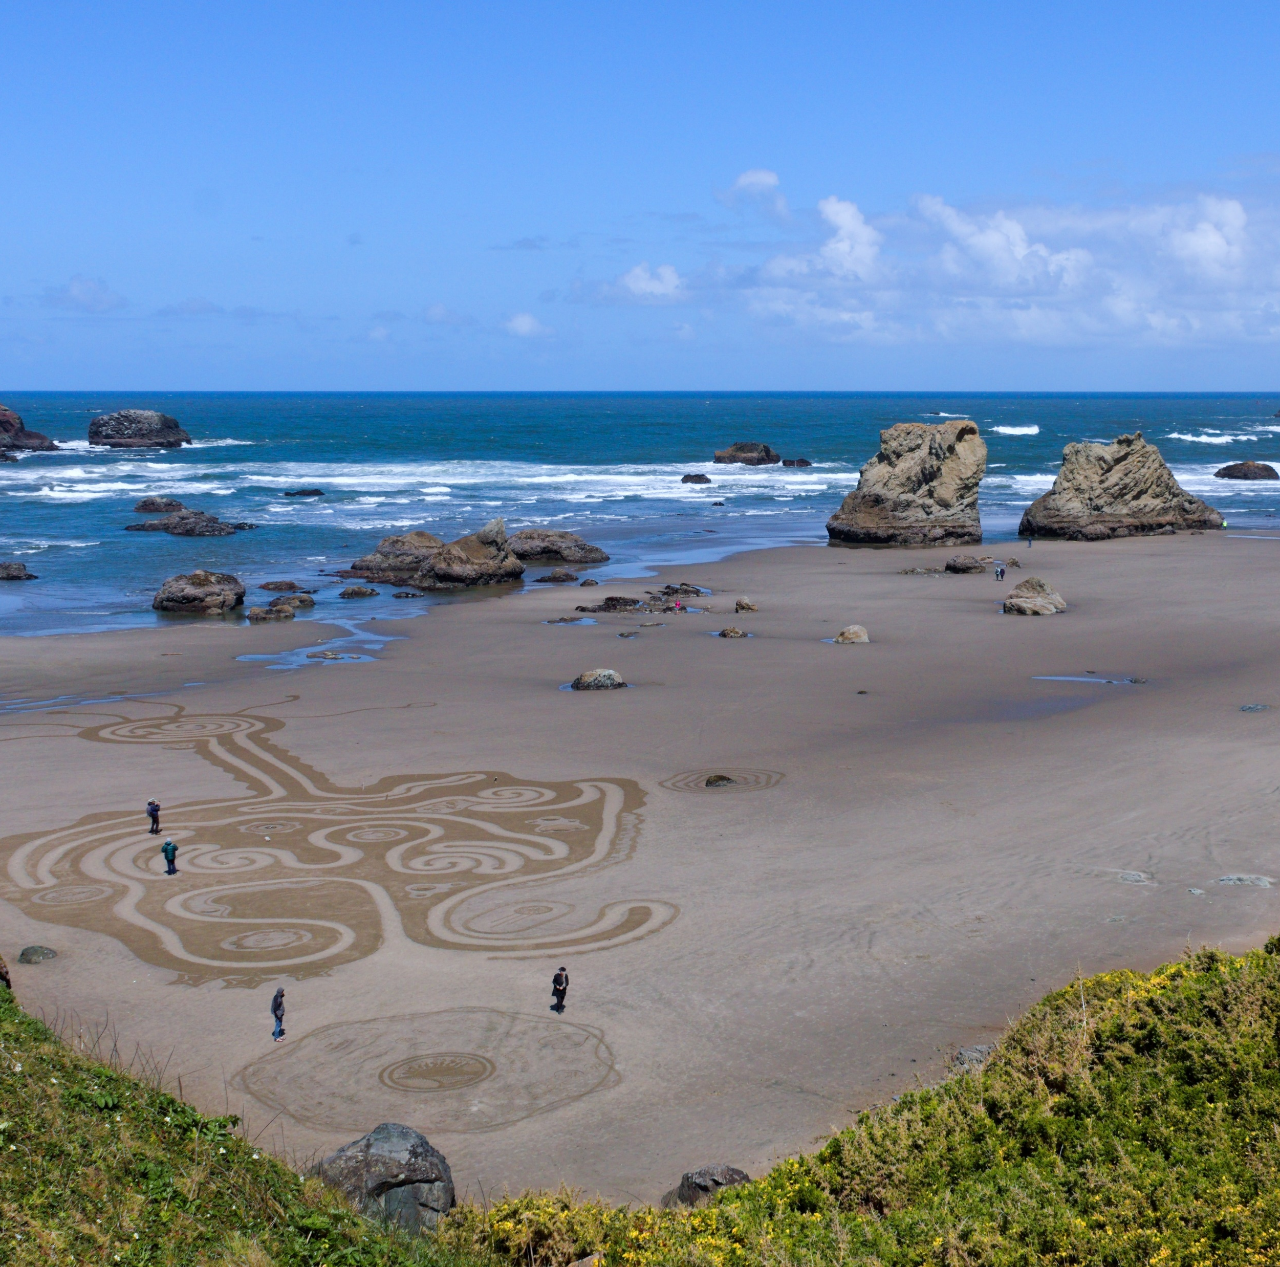
What Is a TSP?
Transportation System Plan
Addresses transportation needs now and into the future
20-year plan
Contains:
Projects (ex: new sidewalks)
Programs (ex: parking management)
Policies (ex: coordination with transit providers)
Standards (ex: street widths)
Updating Bandon’s 2000 TSP!
Notes:
Ryan

Slide 7
What Is a TSP? (Continued)
Will look at all modes (ways of getting around)
Walking
Driving
Biking
Bus
Freight / deliveries
Special focus on:
U.S. 101 solutions – balancing the needs of those who use it
Developing streets for all people no matter how they travel
Addressing tourism travel impacts
More connections across and through town
Notes:
Ryan

Slide 8
What Is a TSP? (Continued)
Goals and objectives to guide process
Prioritize projects, programs
Funding options
City code updates
Comply with state rules
Consider rules for new development
Notes:
Ryan

Slide 9
Schedule
Expected to continue into late 2024
Notes:
Ryan

Slide 10
Needs and Issues
What we've heard:
U.S. 101 solutions – balancing the needs of those who use it
Developing streets for all people no matter how they travel
Addressing tourism travel impacts
Parking needs
Congestion
Safety
More connections across and through town
Notes:
Ryan

Slide 11
Needs and Issues
Discussion
What do you think are the main transportation issues to focus on in Bandon?
Did we miss anything?
Notes:
Ryan

Slide 12
Goals and Objectives
TSP goals and objectives will set a desired vision for the future.
Notes:
Emily - Developed these goals and objectives based off of the 2000 TSP Goals, Bandon Comprehensive Plan Goals, 2021 Transportation Growth Management Grant Application Objectives, and conversations with the project management team. We’re looking for input from the PAC on these goals, to make sure we’ve covered everything that will be important to developing transportation projects and programs in Bandon. These goals will help us develop transportation projects and programs while updating the TSP, and will be used to evaluate and prioritize potential projects.

Slide 13
Goals
Transportation for All Users
Economy and Livability
A System for All Modes
Sustainability
Fiscal Responsibility
Notes:
Emily - Goals are higher-level – the main things we want to focus on. Objectives provide more measurable detail for each goal, and were used to develop the evaluation criteria for selecting and prioritizing projects.

Slide 14
Goal 1
Transportation for All Users
Provide a safe, reliable, and convenient transportation system for everyone, emphasizing the needs of transportation disadvantaged people; groups that have difficulty in obtaining transportation because of their age, income, or physical or mental disability.
Notes:
Emily - accessible to groups that have difficulty in obtaining transportation, address safety issues, streets that provide connectivity for all users, maintain acceptable traffic flow and minimize delay.

Slide 15
Goal 2
Economy and Livability
Ensure the transportation system supports making Bandon a great place to live, work, and do business.
Notes:
Emily - Minimize negative impacts to people, places, and natural features. Balance needs on U.S. 101 for regional traffic, business, people walking, biking, or using a mobility device. Develop projects scaled appropriately. Address tourism impacts. Coordinate with local, state, and regional agencies.

Slide 16
Goal 3
A System for All Modes
Develop a multimodal transportation system that supports people safely and comfortably cycling, walking, and taking transit.
Notes:
Emily - Develop a connected and safe network of walking and cycling routes that connect to key destinations. Decrease conflicts between modes. Make it easier to get around town on foot, by bike, or by mobility device. Improve public transportation.

Slide 17
Goal 4
Sustainability
Foster a sustainable transportation system by maintaining and preserving the existing system, mitigating impacts from new development, integrating safety and emergency preparedness, and meeting the present and future needs of Bandon.
Notes:
Emily - Coordinate transportation improvements with City land use planning and new developments. Preserve and maintain the existing system before making new investments. Avoid impacts to natural features. Develop and maintain evacuation routes in case of emergencies and natural disasters.

Slide 18
Goal 5
Fiscal Responsibility
Develop projects and programs that consider potential funding sources, partnerships, and cost.
Notes:
Emily - Evaluate new local funding options for transportation projects. Projects should align with federal, state, and regional grant programs, partnership opportunities with other agencies. Emphasize easily fundable, low-cost enhancements.

Slide 19
Goals Discussion
Are these the right goals?
Is there anything missing?
Is there anything we should add or change?
Notes:
Emily

Slide 20
Next Steps
Notes:
Ryan

Slide 21
Next Steps
PAC Feedback
Send to Dana at dnichols@ci.bandon.or.us
Existing and Future Conditions Analysis
Next meeting: October 2023
Discussion of Existing and Future Conditions
Online Open House #1
Notes:
Ryan

Slide 22
Thank you!
Notes:
Ryan/Dana

