Slide 1
City of Bandon
TRANSPORTATION SYSTEM PLAN
Project Advisory Committee Meeting #2
November 1, 2023 – 10 am – 11:30 AM
Notes:
Dana

Slide 2
Meeting Guidelines
Please mute when not speaking
Let us know when you’d like to speak:
Send a note in chat
Use the “raise hand” feature
If we don’t get to your comment/question, email Dana after the meeting: dnichols@ci.bandon.or.us
Please promote respectful dialogue and comments
Notes:
Dana

Slide 3
Agenda
Welcome and Introductions
TSP Context (Review)
Overview of project
Existing Conditions
Future Conditions
Issues and Needs
ODOT review
U.S. 101: function, capacity, and performance standards
Next Steps
Notes:
Dana

Slide 4
Introductions
Name
Affiliation, interest
Notes:
Dana

Slide 5
PAC Role (Review)
Participate in all five meetings
Help review goals, identify needs, select projects
Advise and provide feedback to the TSP team throughout the process

Slide 6
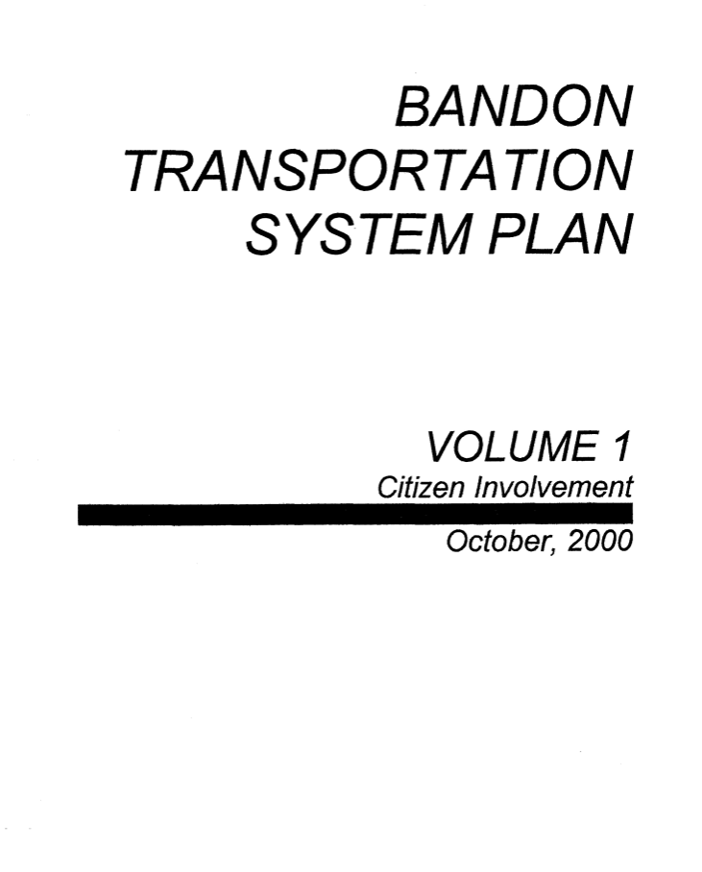
What Is a TSP?
Transportation System Plan (TSP)
Addresses transportation needs now and into the future
20-year plan
Contains:
Projects (ex: new sidewalks)
Programs (ex: parking management)
Policies (ex: coordination with transit providers)
Standards (ex: street widths)
Updating Bandon’s 2000 TSP!

Slide 7
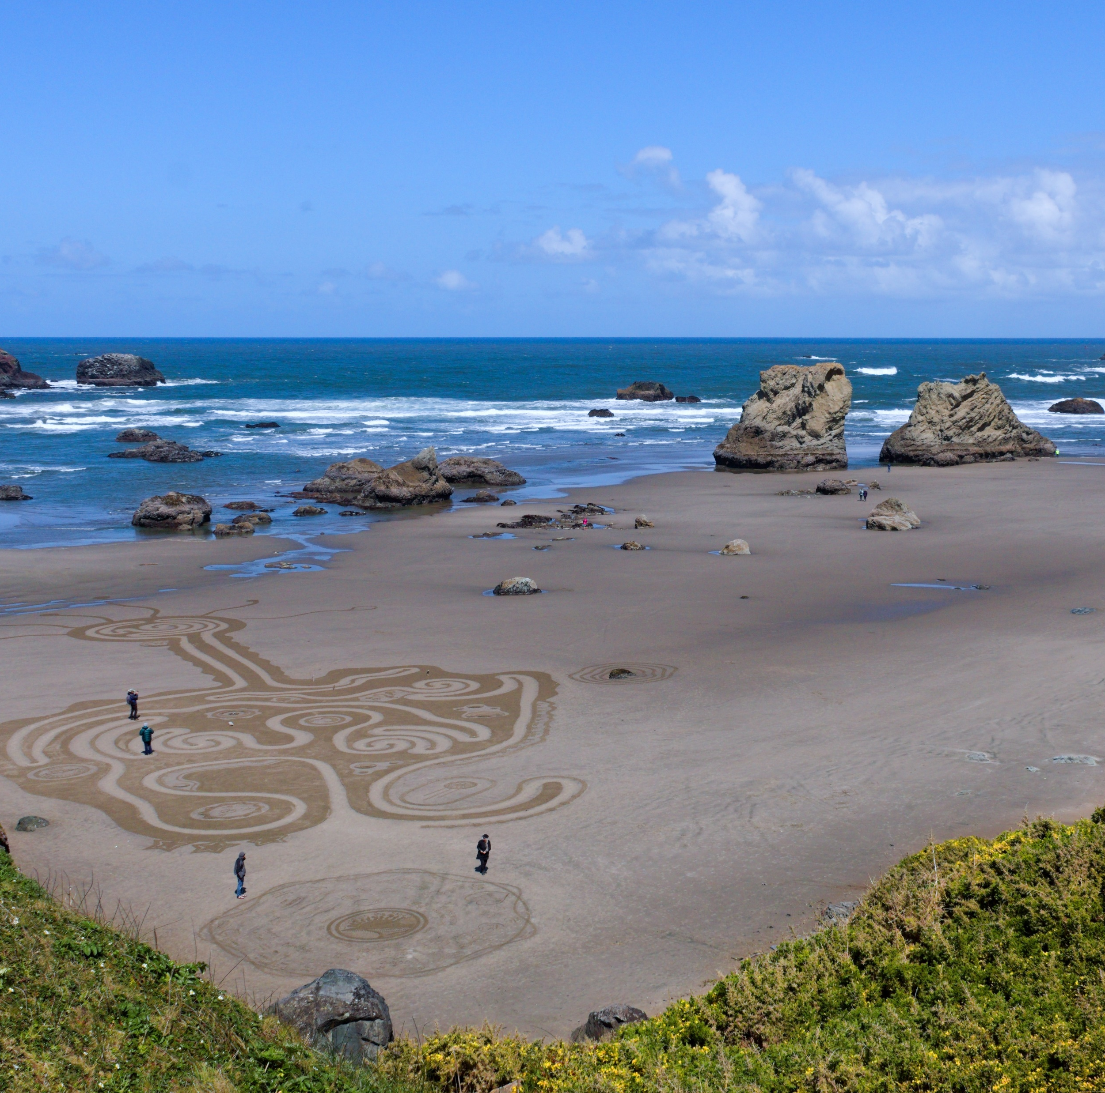
What Is a TSP? (Continued)
Will look at all modes (ways of getting around)
Walking
Driving
Biking
Bus
Freight / deliveries
Special focus on:
U.S. 101 solutions – balancing the needs of those who use it
Developing streets for all people no matter how they travel
Addressing tourism travel impacts
More connections across and through town

Slide 8
What Is a TSP? (CONTINUED)
TSP Purpose
Must identify an integrated network of multi-modal transportation facilities and services that can support development of the City’s existing and planned land uses.
Transportation needs within City limits and the Urban Growth Boundary.
US 101 redesign and beautification, access management, and future movement to and through “the Donut Hole” as high priorities
Updated TSP must meet the requirements of the Transportation Planning Rules.

Slide 9
What Is a TSP? (Continued)
Project Objectives:
TSP Update: Address gaps in walking, cycling, and public transportation infrastructure. Identify projects that can receive funding resources.
Create Communities: Define key connections between the city’s economic centers and parks, schools, and housing with safety and multimodal accessibility in mind. Address safety issues and user conflicts along US 101. Creating a community along the highway corridor can be difficult with unmanaged crossings, speeding , and parking and access conflicts.
Support Economic Vitality and Growth: Address two major growth concerns: Parking and circulation in economic centers, and preparing for future growth in the Donut Hole.
Save Public and Private Cost: Review and update the current street standards. A plan for connections through the Donut Hole will help ensure the UGB can accommodate future growth with access to existing City services.
Promote Environmental Stewardship: Identify a backbone bike and pedestrian system to improve connectivity, to help reduce VMT, reduce emissions and greenhouse gases, and to encourage healthy lifestyles and livable environments.

Slide 10
What Is a TSP? (Continued)
Goals and objectives to guide process
Prioritize projects, programs
Funding options
City code updates
Comply with state rules
Consider rules for new development

Slide 11
Schedule
Expected to continue into late 2024
We are here!

Slide 12
Existing Conditions
Issues and Needs

Slide 13
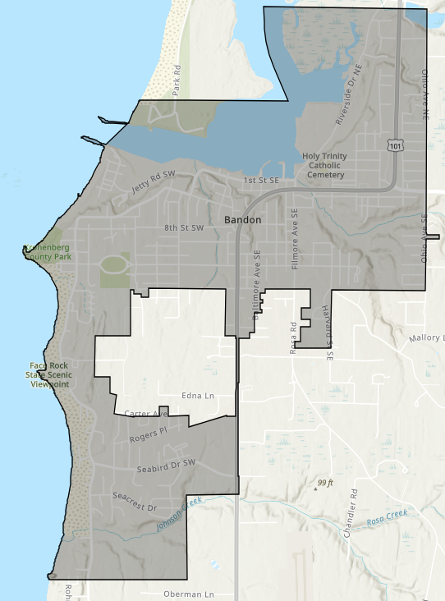
Issues and Needs (Street Network)
Not many connected north-south and east-west roads
Bandon’s Donut Hole lacks roadway connections.
Conflicts between vehicle traffic and pedestrians on U.S. 101
U.S. 101 does not meet state standards for bike/pedestrian facilities under ODOT Blueprint for Urban Design

Slide 14
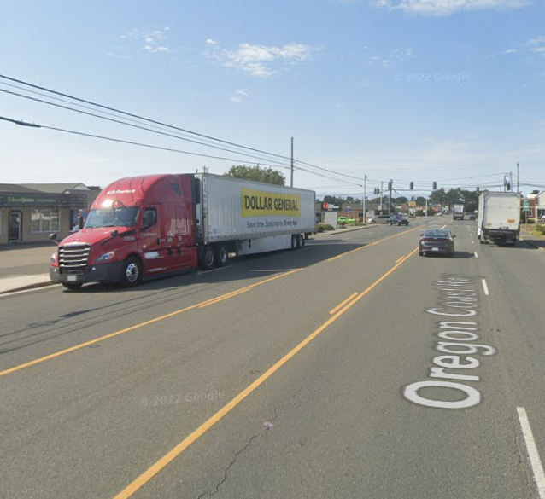
Issues and Needs (Freight)
U.S. 101 is a freight route, Reduction Review Route and Principal Arterial Roadway.
Congestion from turning freight trucks on U.S. 101
Additional roadway connections from U.S. 101 could allow trucks to avoid passing through the center of Bandon
No truck loading zones
Can cause issues with blocking the roadway
Old Town
Grocery stores
Notes:
Features that would reduce vehicle-carrying capacity on Reduction Review Routes must be in compliance with Oregon statute - this must be due to safety or access considerations and freight movement must not be unreasonably impeded.

Slide 15
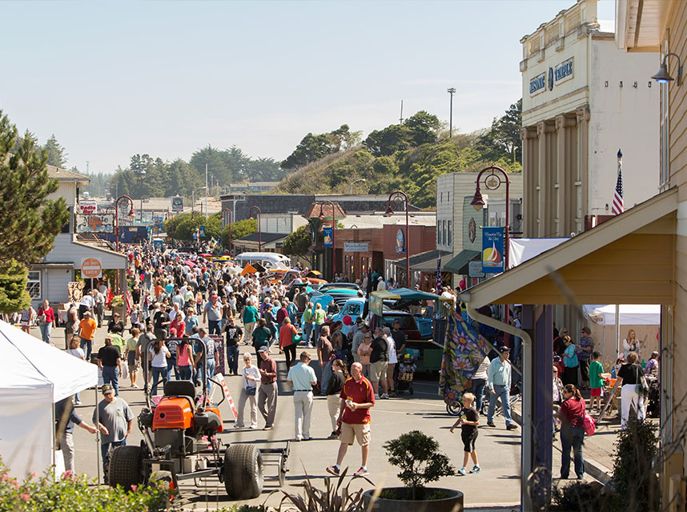
Issues and Needs (traffic and Parking)
Increase in tourism traffic during summer
On-street parking in Old Town can be busy during summer months
Lack of signage directing to public parking lots
Parking is not time-limited
Lack of comfortable crosswalks for pedestrians and bicyclists near parking lots
Notes:
Mention access to the transit stop at Ray’s

Slide 16
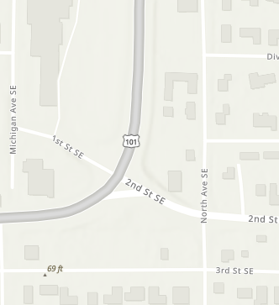
Issues and Needs (traffic and Parking)
Mobility Targets. Only one intersection is expected to exceed its “volume to capacity” mobility target: U.S. 101 and 1st Street/OR 42S.
Mobility Target: v/c < 0.90 Actual: v/c 0.90
This intersection operates at a level of service (LOS) D.
This intersection may require additional measures to meet mobility targets in the future.
Traffic Congestion. City staff and community members have noted seasonal congestion from tourist traffic. Though actual measured delay is not substantial, congestion occurs during busy summer months at certain times.
Notes:
Roadway mobility targets are based on volume-to-capacity (v/c) ratios. ODOT has standards for how long it takes drivers to get through intersections on US 101.
Perceptions of congestion are equally important to consider. During congested periods, particularly when tourism levels are high in the summer, drivers may behave in ways that compromise safety for all roadway users, and delays are especially frustrating for residents.

Slide 17
Issues and Needs (Walking)
Bandon is generally walkable
Need for safer crossings for pedestrians and bicyclists, particularly across U.S. 101
Sidewalk gaps:
Beach Loop Rd
11th Street
8th Street
Oregon Avenue
Jetty Road
Limited street lighting outside of Old Town

Slide 18
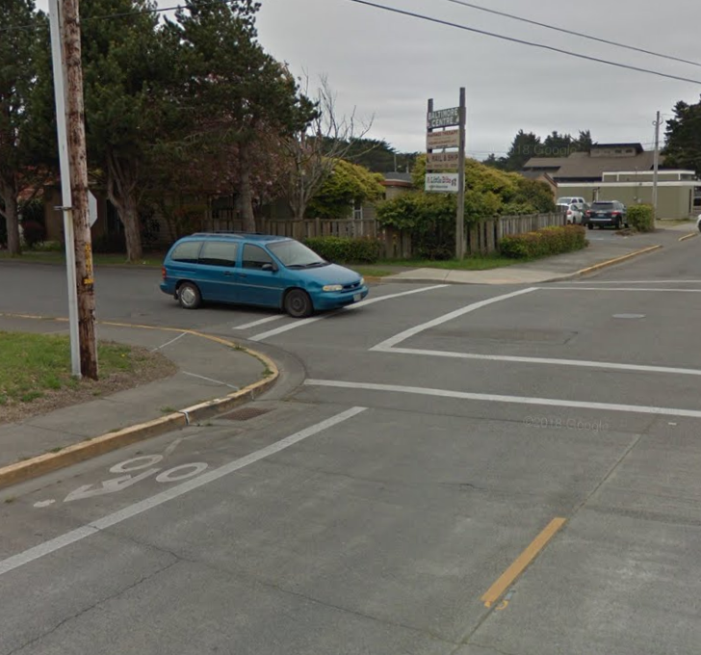
Issues and Needs (Biking)
Incomplete bike network
Most roads in Bandon do not have bike facilities
Many streets in Bandon could be candidates for shared bikeways or shoulder bikeways as “neighborhood greenways”
Desire for safe and comfortable interconnected bicycle network through and between Bandon’s neighborhoods.

Slide 19
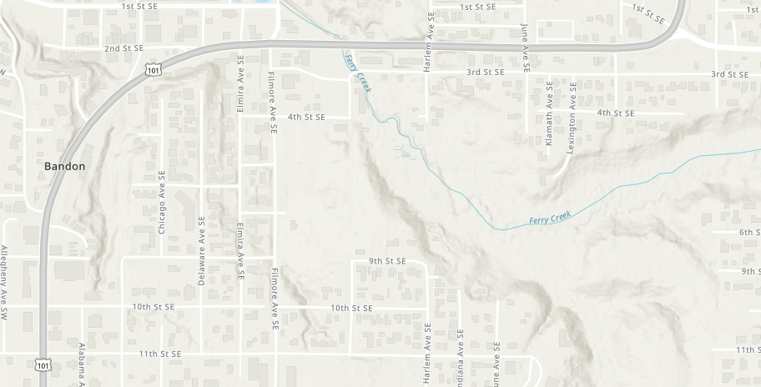
Issues and Needs (Safety)
Most crashes are on U.S. 101
11th Street to Face Rock Creamery sees the highest number of crashes
Curve along U.S. 101 may cause visibility issues
Can be stressful for people walking to cross U.S. 101
30mph speed limit in this area
Distances between crosswalks
OR 42S to Fillmore Ave = ~2,400 ft
Fillmore to Chicago Ave = ~1000 ft
Chicago Ave to 9th St = ~1,500 ft

Slide 20
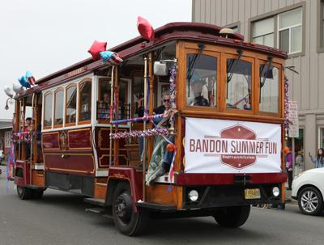
Issues and Needs (Public Transportation)
Only current service within the City is Bandon Dial-a-Bus
Many do not know about Bandon Dial-a-Bus
Requires riders to plan and schedule trips ahead of time
Improved public transportation to Coos Bay and Langlois
Community interest in reinstating Tourist Trolley or local shuttle
Bus stop at Ray’s lacks seating and is largely unmarked
Photo: Autumn Moss-Strong, Bandon Western World

Slide 21
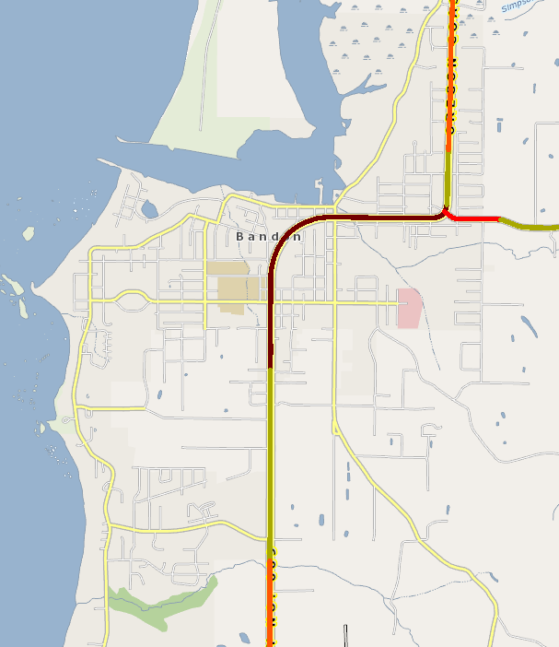
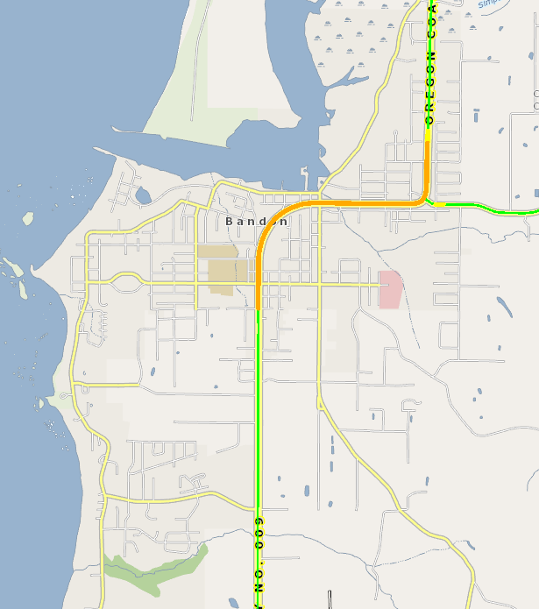
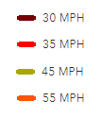
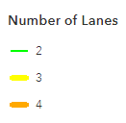
ODOT Review – U.S. 101
Speed Limits
Number of Lanes
5
Notes:
Tom

Slide 22
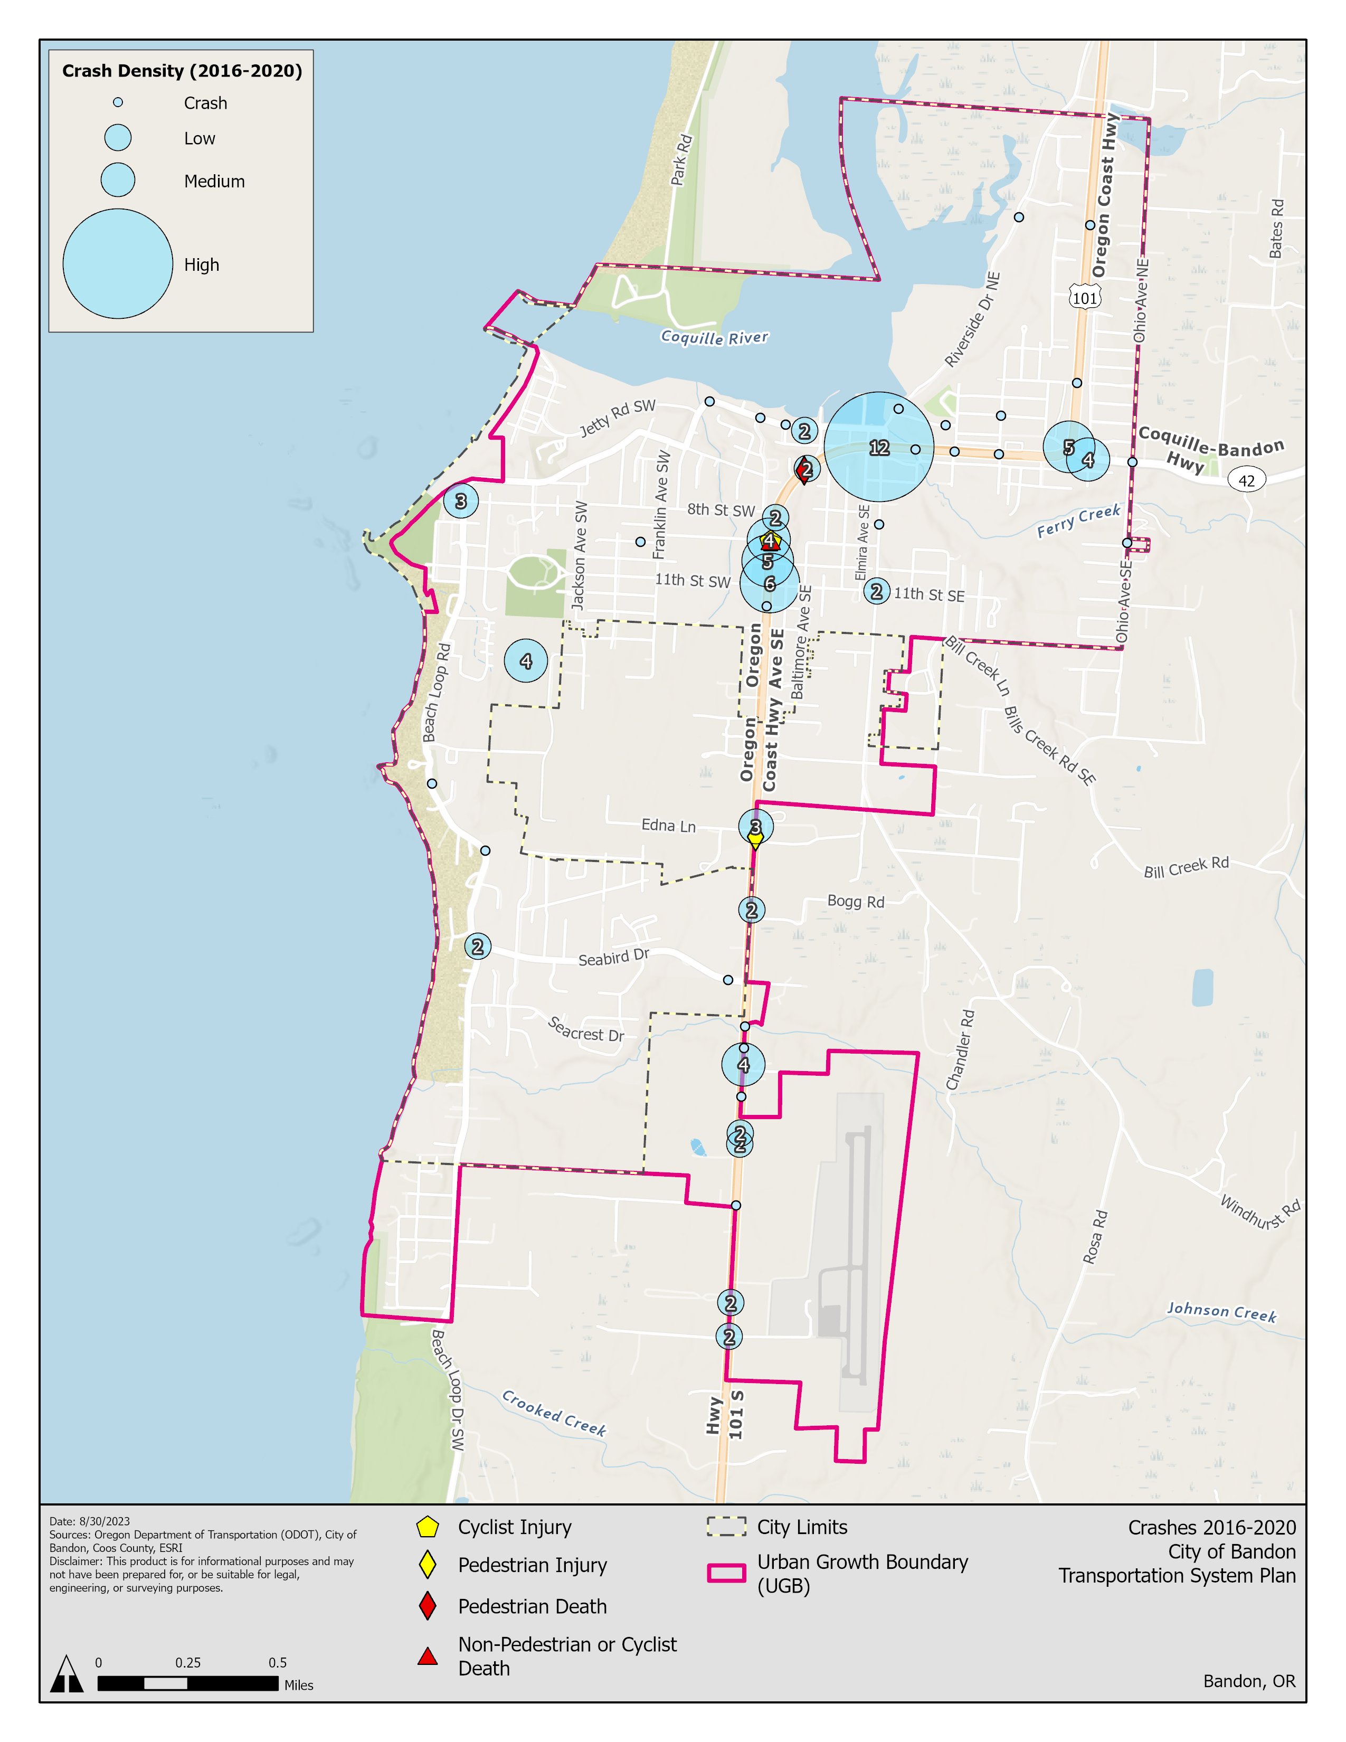
ODOT Review – U.S. 101
Notes:
Crashes are clustered along the curve of US 101 and near 42S

Slide 23
ODOT Review – U.S. 101
Bike/Pedestrian Deficiencies: Sidewalks along U.S. 101 generally are not separated from vehicle traffic by a landscape buffer or bike lanes. No bike lanes are present on U.S. 101 from OR 42S to 13th Street.
ODOT’s Blueprint for Urban Design recommends separated bicycle facilities within the Commercial Corridor context.
Capacity: Traffic along U.S. is generally not expected to exceed standards except for one intersection (42S)
Notes:
Tom

Slide 24
Future Conditions

Slide 25
Future Conditions
Analysis considers the likely future conditions of Bandon’s transportation system under a Future “No Build” condition.
“No Build” conditions refer to the transportation system in 2045 if there are no investments beyond projects already programmed for construction.
Analysis considers likely future growth in transportation demand, population growth, and changes in land use.
Notes:
The Future No Build traffic analysis accounts for completed or planned transportation improvements that have an identified and committed funding source. Since the one planned and funded project within the Bandon UGB (Ferry Creek Bridge) does not change roadway capacity or traffic patterns, no changes were made to the roadway network for traffic modeling.

Slide 26
Future Conditions (Traffic)
Future traffic forecasts for the horizon year 2045 were developed using a growth factor
Only one intersection is expected to exceed its “volume to capacity” mobility target in the future: U.S. 101 & 1st Street/OR 42S.
Mobility Target: v/c < 0.90 Future: v/c 0.90
This intersection is expected to operate at a level of service (LOS) D.
Notes:
The Future No Build traffic analysis accounts for completed or planned transportation improvements that have an identified and committed funding source. Since the one planned and funded project within the Bandon UGB (Ferry Creek Bridge) does not change roadway capacity or traffic patterns, no changes were made to the roadway network for traffic modeling.

Slide 27
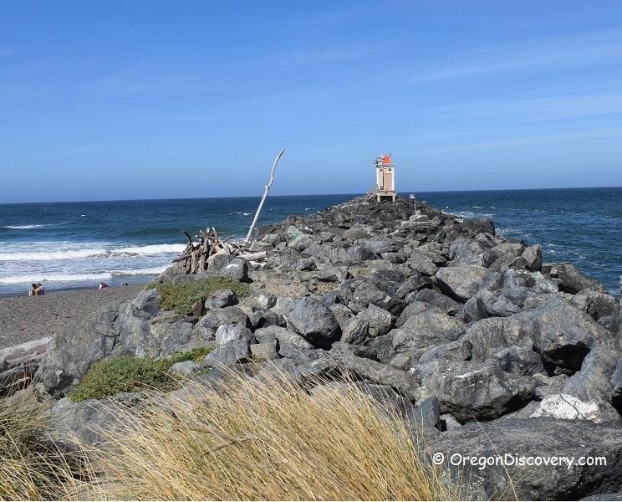
Future Conditions (Walking and Biking)
The only currently funded bicycle and pedestrian project is the Jetty Park Trail.
Jetty Park Trail - Connection between Old Town and the Jetty Park – pathway that connects 1st Street SW in Old Town to the Jetty.
Gradual increases in population, tourist demand, and traffic could impact bicycle and pedestrian safety in the future.

Slide 28
Discussion

Slide 29
Existing Conditions Discussion
Do these conditions resonate with your impression of Bandon’s transportation system?
What works well now?
What’s one thing you’d like to change?
What issues or needs do you see?
Is anything missing?

Slide 30
Needs and Issues Discussion
Have we captured all important needs and issues?
Is there anything we should add or change?

Slide 31
Next Steps

Slide 32
Community Engagement
Milestone #1: Share information and gather public feedback about the overall TSP process, TSP goals, transportation issues, needs, and priorities in Bandon.
Completed Community Representative Interviews
Online Open House –
Launches November 1st (today!) – closes mid-December
Includes a survey and a comment map.
Help us get the word out!

Slide 33
Next Steps
PAC Feedback
Send to Dana at dnichols@ci.bandon.or.us
Development of Transportation Improvements
Next meeting: December 2023
Discussion of transportation improvements

Slide 34
Thank you!

Slide 35
ODOT Review – Lane Reconfiguration
5 lanes on U.S. 101
Facilitates passing/speeding in Bandon
Not a capacity issue according to traffic analysis
AADT along U.S. 101 ranges from 8,500 to 14,650
Can lead to safety issues for people walking and biking
Notes:
Tom

Slide 36
ODOT Review – U.S. 101
South city limits to 13th Street and from north city limits to roughly 2nd Street
13th Street to north of 2nd Street (1.5 miles)
Notes:
Tom

