Slide 1
Type III, Appeal Public Hearing – 23-045
City Council, February 21st, 2024
Gravel Point – CUP & PR

Slide 2
Overview
The applicant is requesting approval to build:
110-room hotel, meeting rooms (Meadow Lodge)
Restaurant (Dune Lodge)
32 Suites
This property is located in the Controlled Development 1 Zone, and the uses (hotel/motel and commercial retail sales and services) are listed as conditional uses in the zone.
Presentation Title

Slide 3
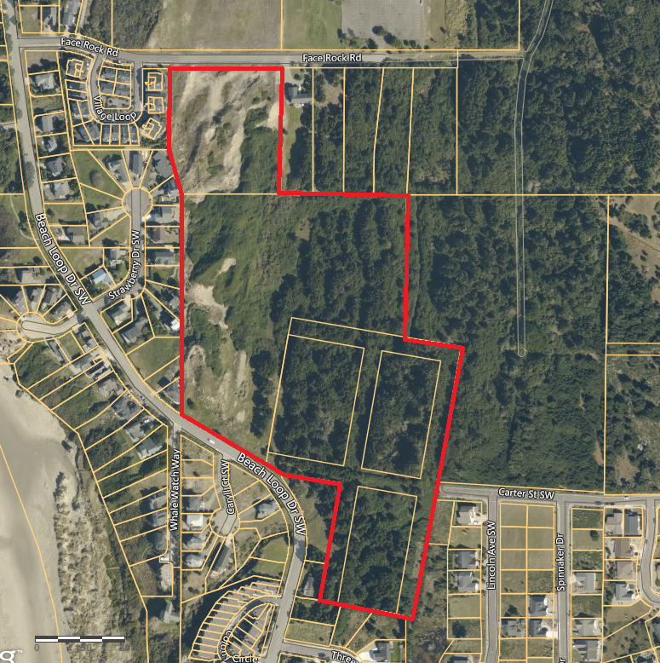
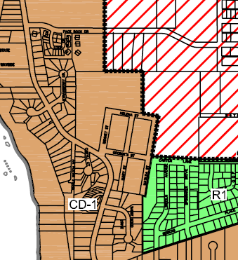
Overview
Presentation Title

Slide 4
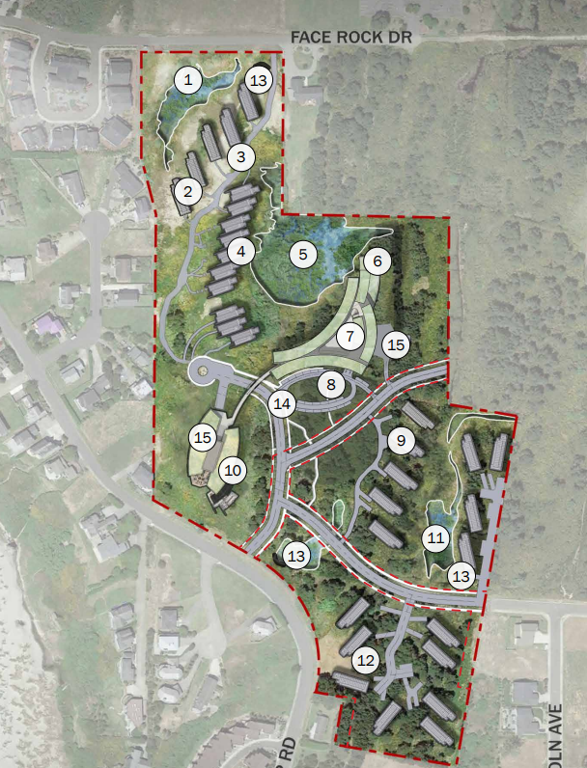
Overview – Site Plan
Presentation Title

Slide 5
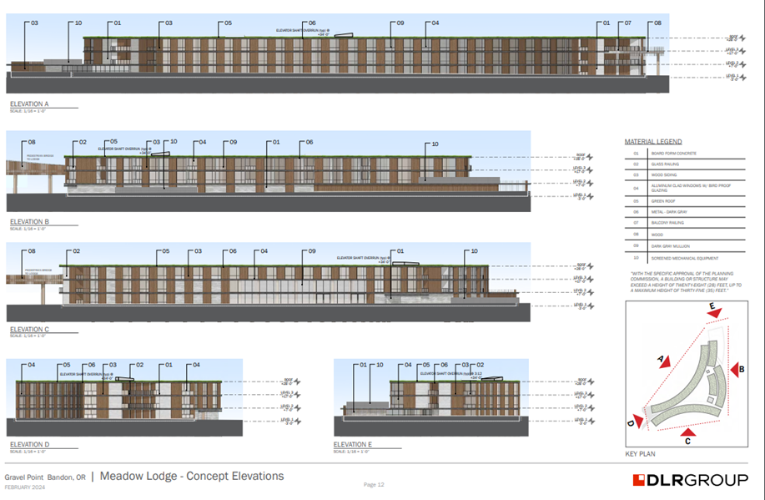
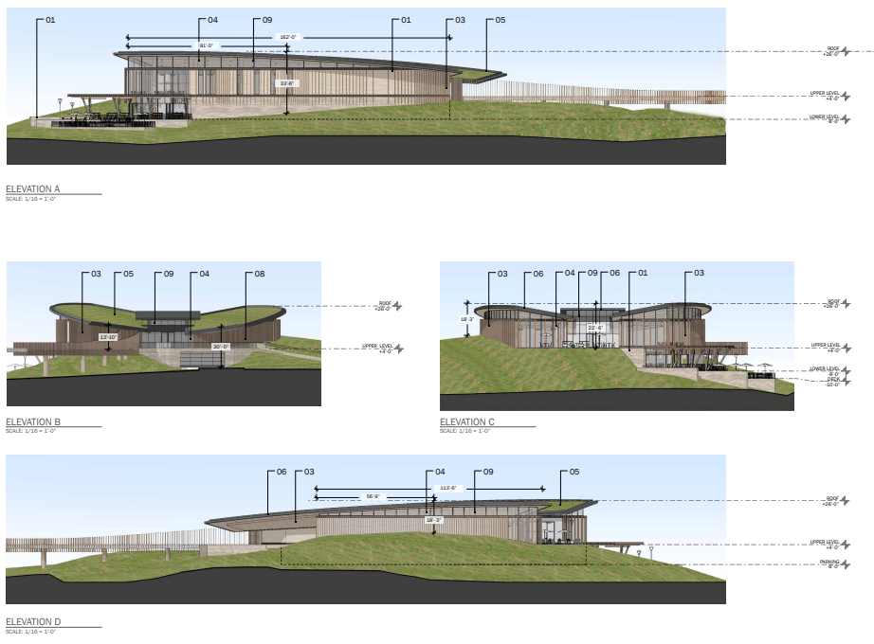
Overview - Buildings
Presentation Title

Slide 6
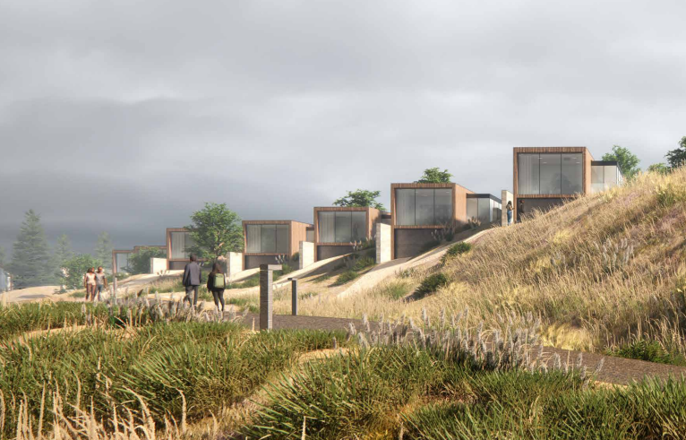
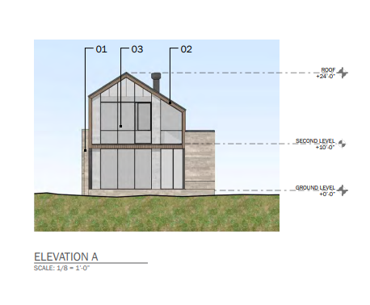
Overview - Buildings
Presentation Title

Slide 7
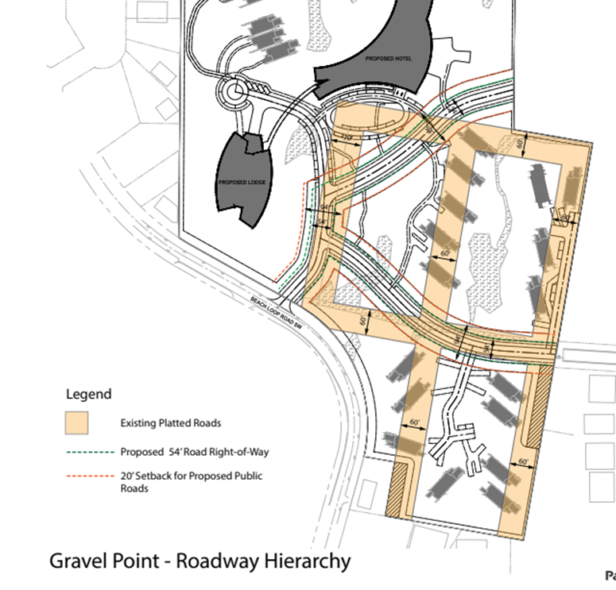
Overview - Streets
Presentation Title

Slide 8
Overview
The Planning Commission held public hearings to review the application, hear testimony, and deliberate towards a decision.
On November 2nd, 2023, the Planning Commission approved the request with conditions.
A Notice of Decision was mailed on November 7th and two valid appeals were received.
Presentation Title

Slide 9
Changes in Application
Withdrawing variance request
Parking
Increasing size of Meadow Lodge and Dune Lodge
Slight Building Coverage increase
Road and Infrastructure (more concrete proposal)

Slide 10
Procedural Burden of Proof
16.12, Conditional Uses
17.20, Controlled Development 1 (CD-1)
17.90, Signs
17.94, Commercial Design Standards
17.96, Off-Street Parking & Loading

Slide 11
CD-1 Zone
The purpose of the CD-1 zone is to recognize the scenic and unique qualities of Bandon’s ocean front and nearby areas and to maintain these qualities as much as possible by carefully controlling the nature and scale of future development in this zone. It is intended that a mix of uses would be permitted, including residential, tourist commercial and recreational. Future development is to be controlled in order to enhance and protect the area’s unique qualities.
Lot size, setbacks, height, lot coverage
Staff finds that there is sufficient evidence in the record to find that the criteria in BMC17.20 have been met.

Slide 12
CD-1 Zone - Height
East of Beach Loop Drive, structures may exceed the 28-foot height limit, up to a maximum of 35 feet if:
The additional height does not negatively impact the views from surrounding properties.
The additional height does not cut off sunlight onto surrounding properties.
The additional height does not negatively impact the aesthetic character of the neighborhood.
All portions of any roofs above 28 ft. are sloped a minimum of 3:12 and must slope down and away from the highest point of the structure.
For each one (1) foot, or portion thereof, that the highest point of the structure exceeds twenty-eight (28) feet, the minimum required front, side, and rear setbacks shall each be increased by one (1) foot.
The building has been lowered so that the only portion exceeding 28 feet is the elevator shaft, which meets the requirements listed above. Staff finds this criteria has been met.

Slide 13
CD-1 Zone - Height
The building has been lowered so that the only portion exceeding 28 feet is the elevator shaft, which meets the requirements listed above. Staff finds this criteria has been met.

Slide 14
Conditional Use Permit
Request is for a hotel and commercial retail sales and services, conditional uses in the CD-1 Zone.
Comprehensive Plan: Tourist Commercial use
Dimensional Standards and Purpose: CD-1 Zone, 23.2-acre site
Adequate Size: 23.2-acre site leaving 80% open space
Site Characteristics: Utilizing topography of the site, only 8.5% is used for development
Public Facilities: Water, sewer, transportation, storm drainage
Neighborhood Impact: Applicant will provide buffering, structures are located far from property lines.
Staff finds there is sufficient evidence in the record to meet criteria. Conditions added: two-year approval, construction traffic mitigation plan, storm drainage mitigation plan.

Slide 15
Public Facilities - Water
City Water Master Plan, 2022: Plan to cover 20-year growth period. Evaluates system performance and identifies potential deficiencies. City has sufficient water rights and water plan capacity. City lacks raw water storage. City engineer confirms current potable water supply is sufficient to serve the proposed use.
Water line on Beach Loop may need to be upgraded. SDC payments will be used for impacts created by new development. There is sufficient water capacity to serve the use.

Slide 16
Public Facilities - Transportation
Table shows “build” and “no build” scenarios with the mobility standards set by the City of Bandon and ODOT. In the build scenario, LOS and v/c are maintained at or below those standards.

Slide 17
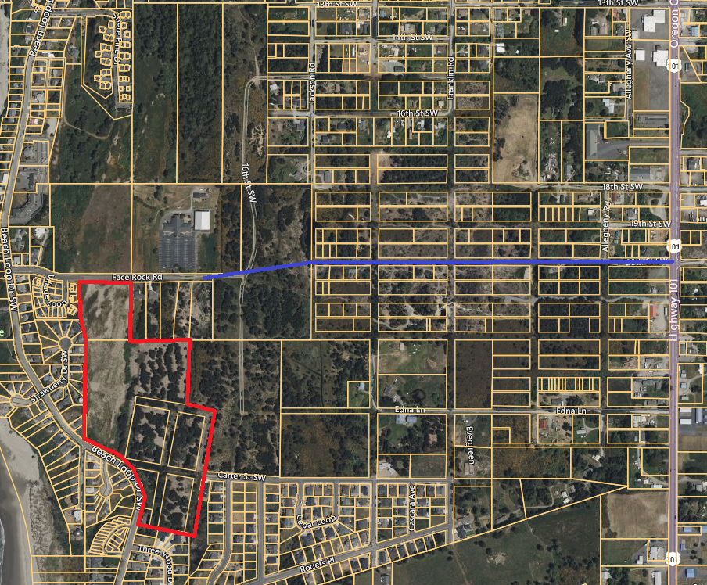
Public Facilities - Transportation
Many requests asking to provide a connection from Face Rock to 20th St to Highway 101 (a planned future collector).
If the Council agrees with TIA and finds that the increase in traffic does not exceed mobility standards, then an off-site improvement requirement would be an unlawful exaction.
Construction traffic mitigation plan

Slide 18
Plan Review
Signs: Requesting two signs – one at main entrance (Beach Loop) and one at side entrance (Face Rock Drive).
Commercial Design Standards: Landscaping plan, screening, lighting, pedestrian amenities, building facades, roof pitch
Parking: Providing 178 vehicle parking spaces and 9 RV parking spaces.
Conditions added: Signs, lighting, landscaping, screening, parking lot standards

Slide 19
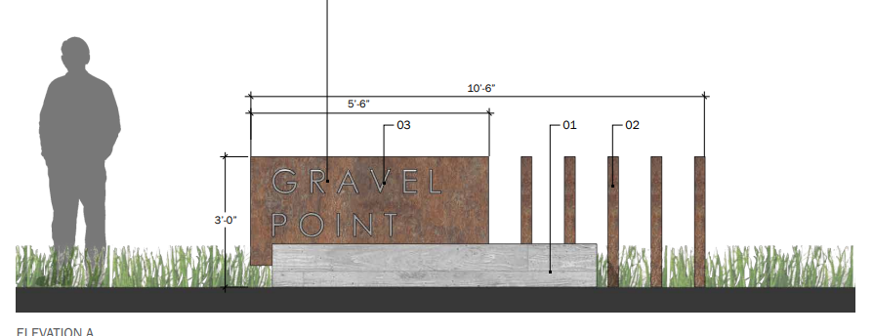
Signs

Slide 20
Wetlands
Site contains two wetlands: TUP-5 and JOH-6.
These wetlands are not significant wetlands as listed in the City’s inventory.
The discretionary criteria in Chapter 17.102 only apply to significant wetlands.

Slide 21
Questions?

